Slide 1
metalearning and autoML
Machine Learning
(Aprendizagem Computacional)
Carlos Soares
csoares@fe.up.pt
[some slides shamelessly stolen from J. Vanschoren]

Slide 2
plan
the world where automated ml lives
a world of many models
needs model management
metalearning/automl can help
but opportunities and challenges are still open

Slide 3
the world where automated ml lives
lots of data
+
lots of detail
+
lots of problems
+
lots of models
=
extreme data mining
(adapted from Soulié-Fogelman)

Slide 4
+ lots of models
more specific knowledge
... that is, models for smaller subsets
e.g. [Fogelman 06]
“broadband communications company moved from 5 cross-sell models per year to 1600;
A wireless communications company that produces 700 CRM models per year;”
... eventually, individual entities
e.g. a recommendation model for each customer
e.g. soft sensors
e.g. UPV’s project with large retail company
50 million models to predict the sales of products

Slide 5
todo
the world where automated ml lives
a world of many models
needs model management
metalearning/automl can help
but opportunities and challenges are still open

Slide 6
extreme data mining
lots of data
+
lots of detail
+
lots of problems
+
lots of models
=
extreme data mining
lots of data mining
(adapted from Soulié-Fogelman)

Slide 7
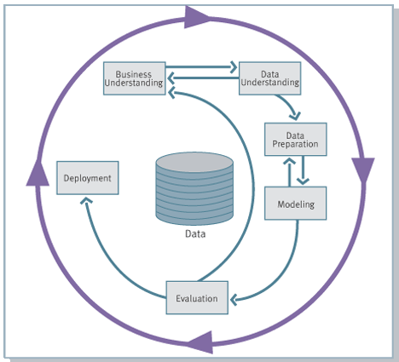

traditional DM methodology
source: Chapman P, Clinton J, Kerber R, et al. CRISP-DM 1.0: Step-by-Step Data Mining Guide. 2000.

Slide 8
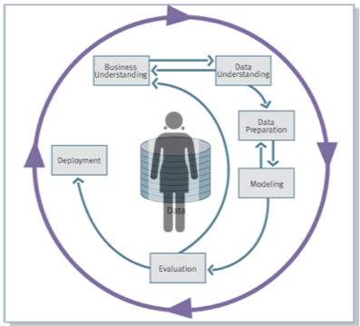
this is not possible!

Slide 9
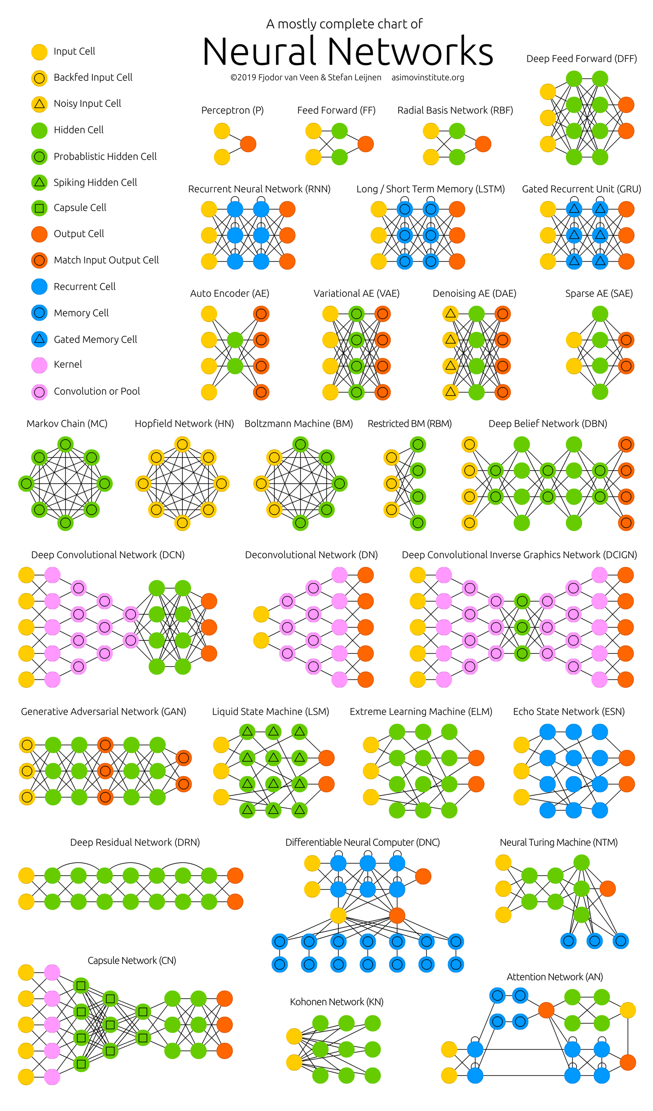
wait, is this really a problem?

Slide 10
bias: can’t live with it
given
dataset
learning algorithm
not every model is possible
e.g. DT and LR
… but not DT and LR
Notes:
easy problem (e.g. diagonal line or vertical line)
given a data sample and a learning algorithm
... not every model is possible
e.g. LD -> diagonal; DT -> vertical

Slide 11
… and can’t live without it
bias-free learning is futile (Mitchell 97, Ch. 2)
an algorithm that assumes nothing concerning the function it is trying to learn has no rational basis to classify unknown cases
bias = criteria to prefer one model relative to another
… so, how to select the best model if all models are considered equally suitable?

Slide 12
the bias-free algorithm
… can learn any model
e.g. the DT and the LR
… but doesn’t have any preference for one over the other
… or for one over the other

Slide 13
... right?
Notes:
LD vs DT

Slide 14
so, if this is not possible?...

Slide 15

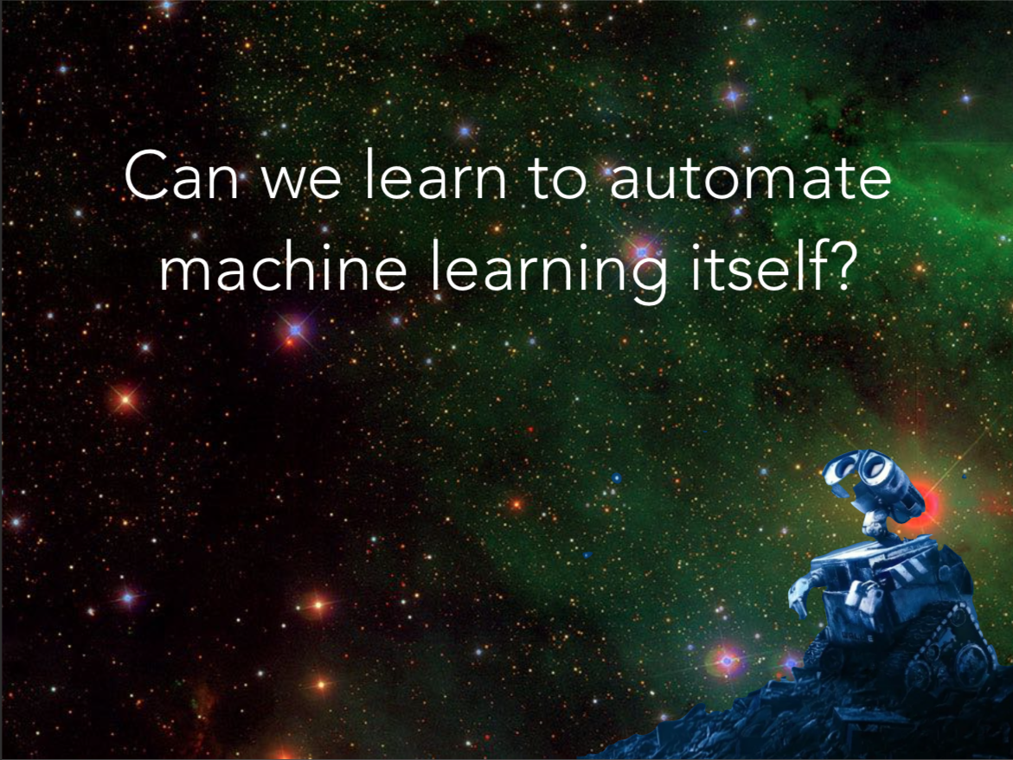
[the dream]
shameless plagiarism of someone who prepares more beautiful slides than I do

Slide 16
... but maybe this is...

Slide 17
todo
the world where automated ml lives
a world of many models
needs model management
metalearning/automl can help
but opportunities and challenges are still open

Slide 18
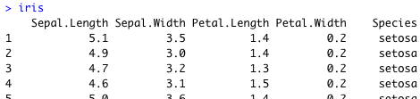
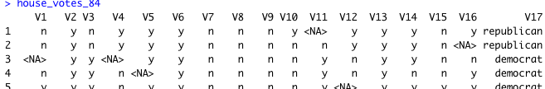
a simple autoML problem: algorithm selection
my
(e.g. churn prediction)
problem
?
DT
RF
how can I use previous experience to help me choose the best algorithm?
DT
RF

Slide 19
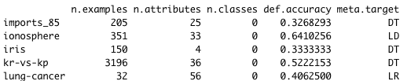
autoML approaches (1/2): metalearning for algorithm selection
my
(e.g. churn prediction)
problem
X
meta-data
metafeature 2
metafeature 1
X =
Brazdil P, Soares C, Costa J. Ranking Learning Algorithms: Using {IBL} and Meta-Learning on Accuracy and Time Results. Machine Learning. 2003;50(3):251-277.

Slide 20
experimental results: an example
when to prune decisions trees
3 classes: prune, don’t prune, doesn’t matter
selected 64 datasets from UCI
metafeatures
entropy of classes (target attribute)
mean entropy of symbolic attributes
positive but not excellent
very simple example
better examples in different contexts
algorithm | accuracy (%)
default | 41
dt | 41
ld | 41
rf | 47
svm | 41
nn | 45
very hard problem

Slide 21
summary
metalearning for algorithm selection
induce model from metadata to predict the best algorithm on a new dataset
(meta)data
_{i} | x_{i,1} | x_{i,2} | x_{i,3} | decision
1 | 0.7 | 327.2 | 0 | A
2 | -0.6 | 1234.2 | 1 | B
3 | ... | ... | ... | ...
train
predict
-0.8 | 37.2 | 1 | ?
0.2 | 14.32 | 1 | ?
... | ... | ... | ...

Slide 22
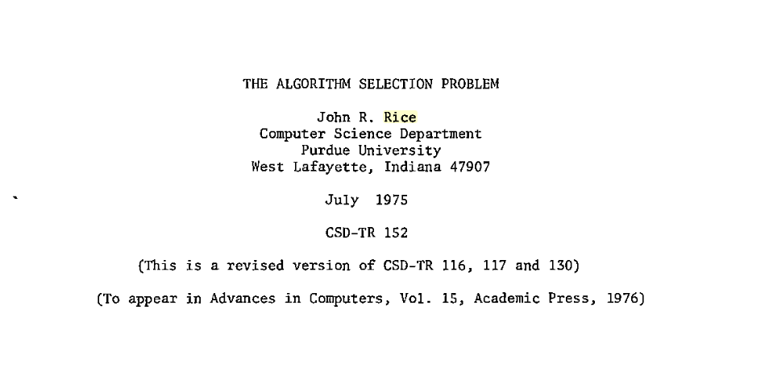
autoML is old

Slide 23
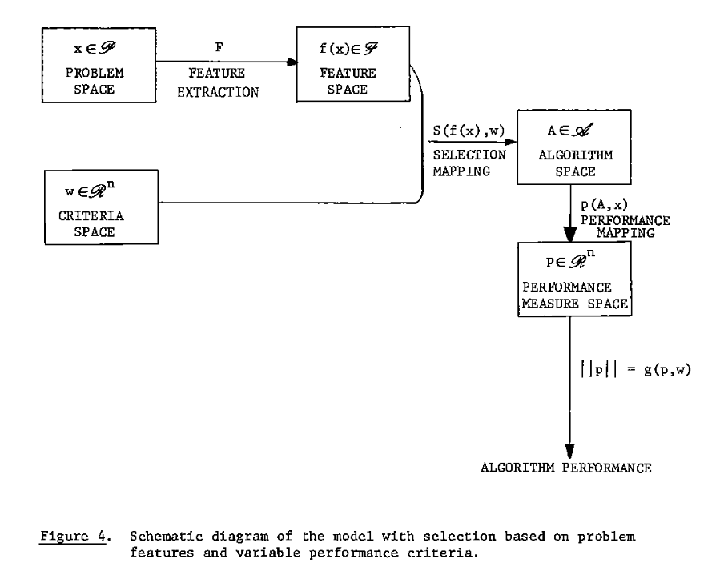
autoML is hard
Rice, J. R. (1976). The Algorithm Selection Problem. In Advances in Computers (Vol. 15, pp. 65–118). https://doi.org/10.1016/S0065-2458(08)60520-3
Notes:
from feature engineering to model generation

Slide 24
autoML is very hard
thanks Catarina Félix!
Notes:
strange behavior of MLP with varying decay rate

Slide 25
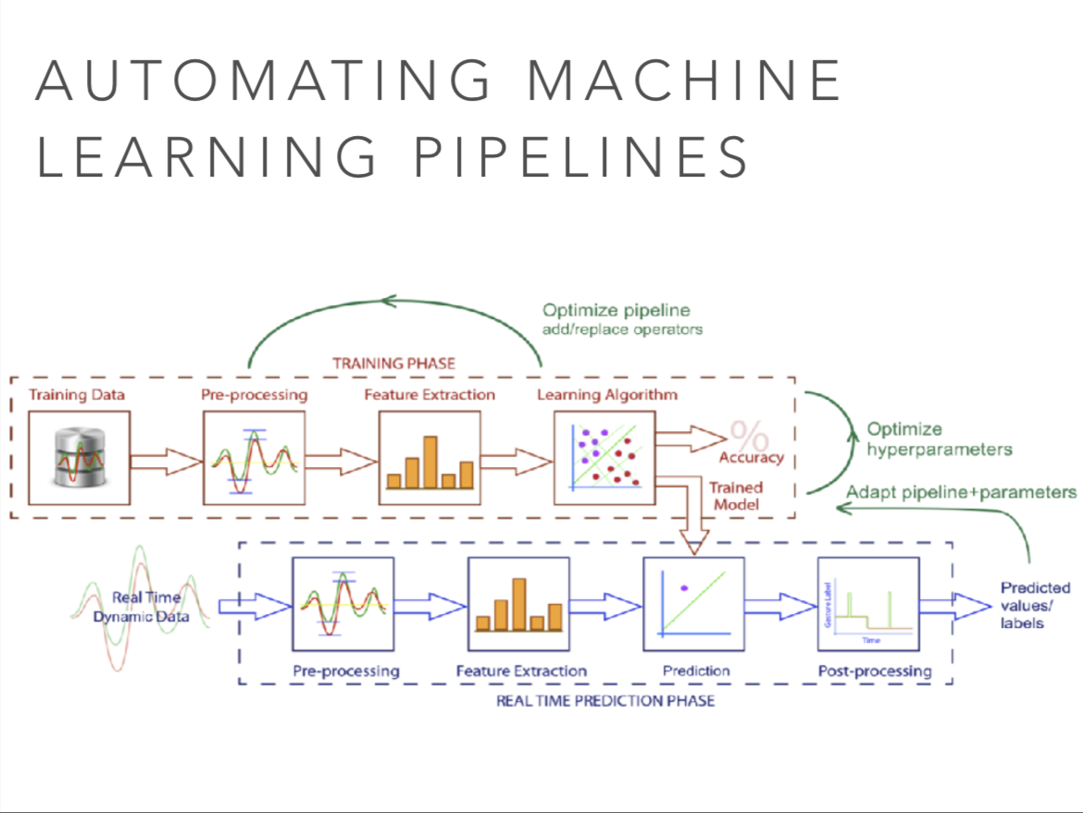
autoML is extremely hard!
can’t resist it: his slides look so much better than mine!

Slide 26
trendy autoML approaches: search and metalearning
M. López-Ibáñez, J. Dubois-Lacoste, L. P. Cáceres, M. Birattari, T. Stützle, The irace package: Iterated racing for automatic algorithm configuration, Operations Research Perspectives, Volume 3, 2016, Pages 43-58, ISSN 2214-7160, https://doi.org/10.1016/j.orp.2016.09.002.

Slide 27
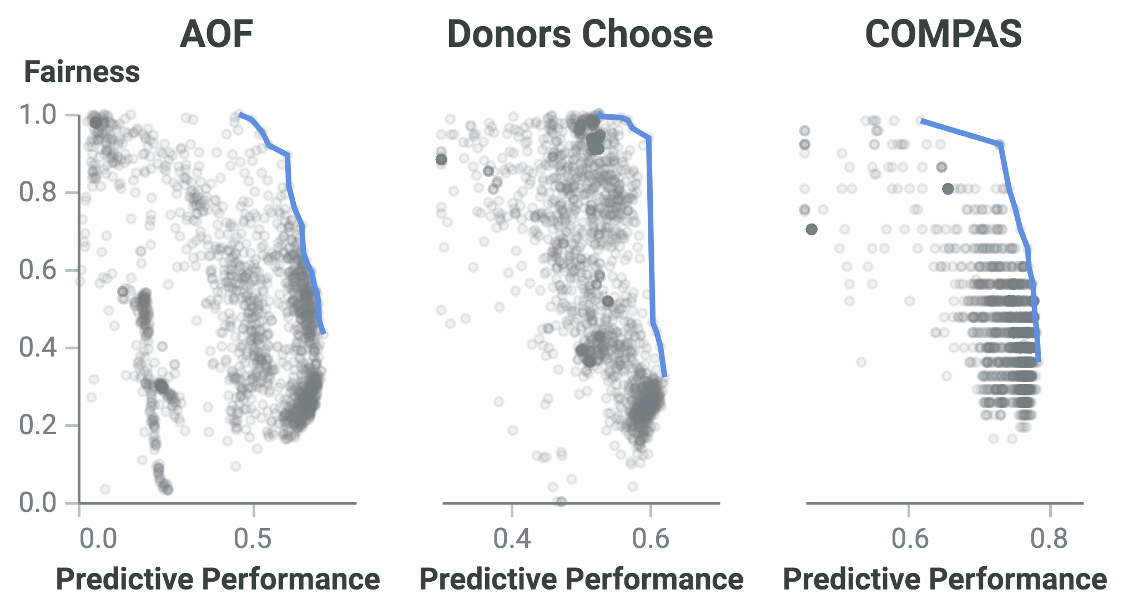
and it’s not only about predictive performance!
responsible AI
is accuracy vs fairness a real problem?
i.e. if I want to promote fair models, I have to sacrifice predictive performance
A. Cruz, P. Saleiro, C. Belém, C. Soares, and P. Bizarro (2021), “Promoting Fairness through Hyperparameter Optimization”, IEEE International Conference on Data Mining

Slide 28
todo
the world where automated ml lives
a world of many models
needs model management
metalearning/automl can help
but opportunities and challenges are still open

Slide 29
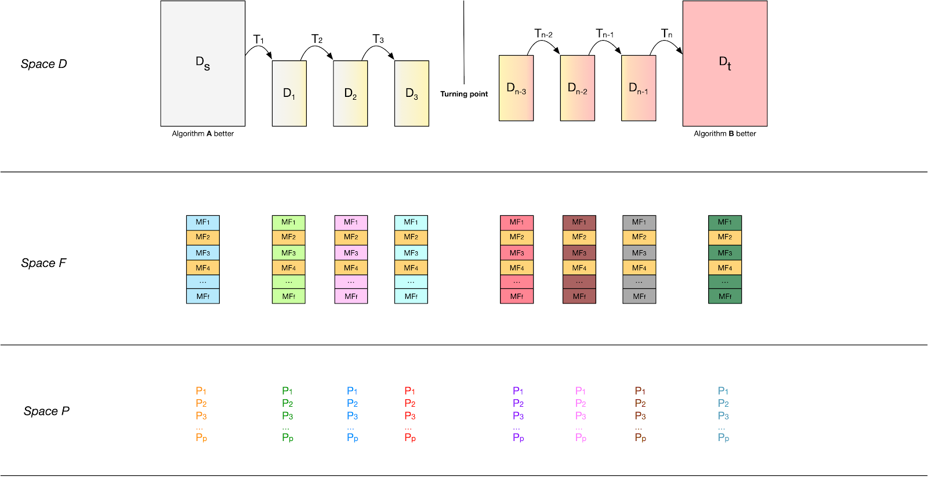
coolest metalearning ever (1/2): dataset morphing to understand ML algorithm behavior
coolest thesis project EVER!
with Alípio Jorge, André Correia

Slide 30
coolest metalearning ever (2/2): dataset characterisation
meta-data
Notes:
addressing the wrong problem

Slide 31
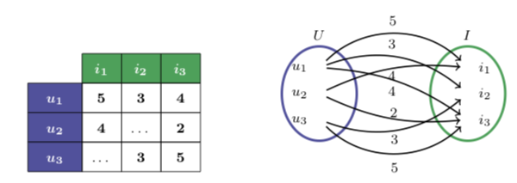
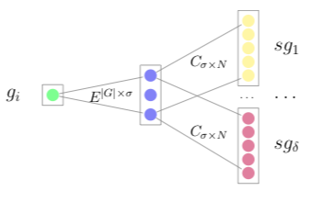
coolest metalearning ever (2/2): dataset embeddings
Cunha, T., Soares, C., & Carvalho, A.C. (2018). cf2vec: Collaborative Filtering algorithm selection using graph distributed representations.
https://arxiv.org/abs/1809.06120v1
Notes:
addressing the wrong problem

Slide 32
but what is fundamentally wrong?
https://datamodelprototype.wordpress.com/2013/10/25/how-to-import-and-export-files-in-rapidminer/

Slide 33
how to make it fundamentally right?
CREATE TABLE LoanRequest (
ID INT PRIMARY KEY,
CustomerID INT REFERENCES Customer(ID) NOT NULL,
Value INT,
Default ENUM(‘y’,’n’) TARGET,
);
SELECT ID, PREDICT(Default) FROM LoanRequest;
Notes:
some attempts in this direction

Slide 34
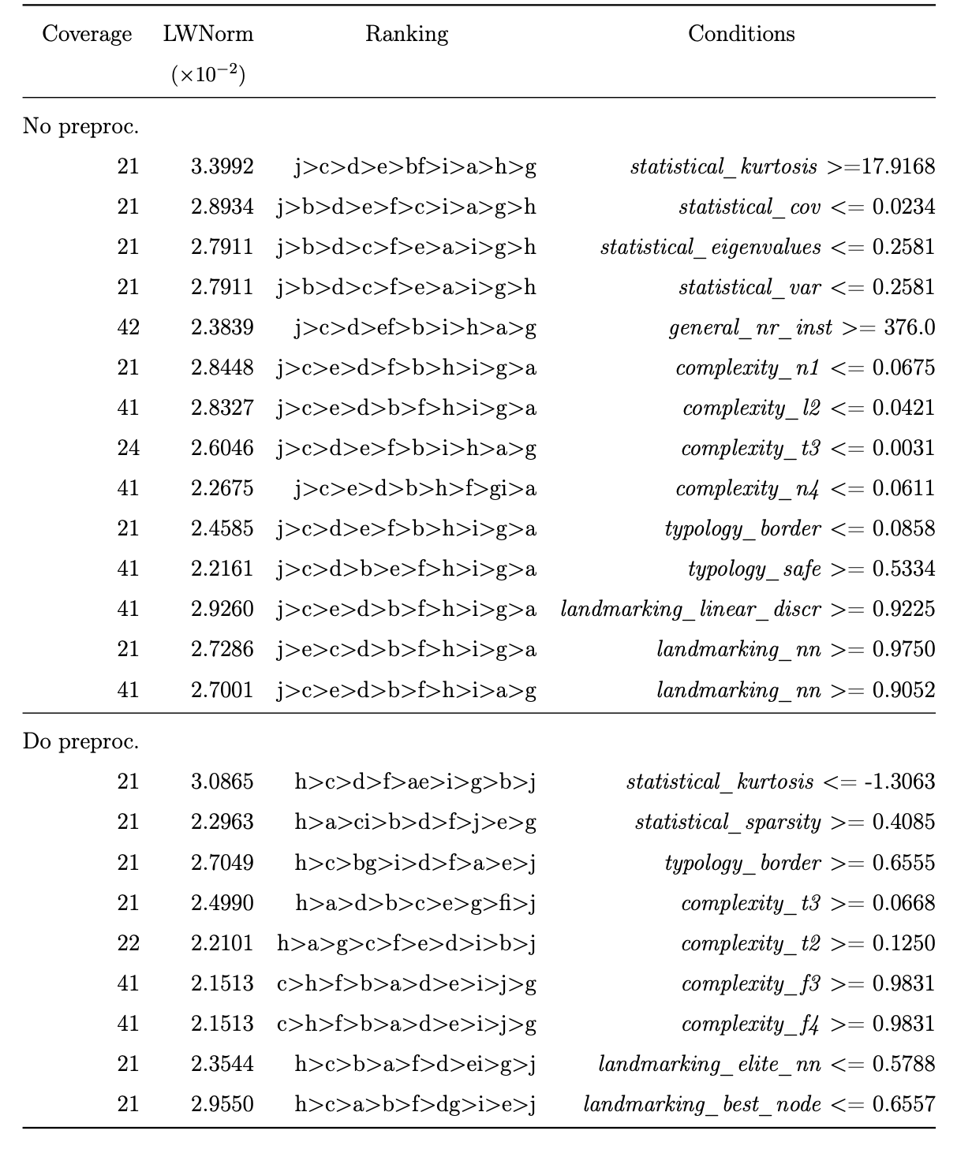
the way to a (real) empirical science of machine learning
metalearning to understand the behavior of algorithms
eg when to do resampling in unbalanced datasets
Costa, Santos, Soares & Abreu. A Meta-Analysis on the Recommendation of Imbalance Strategies (submitted)

Slide 35
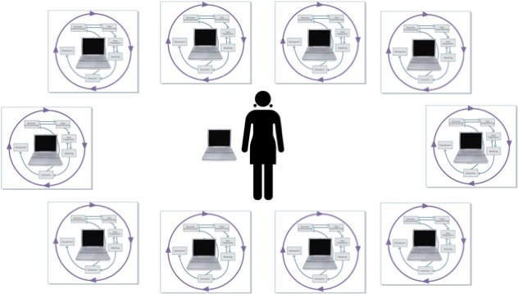
wrap-up
model management
exciting field
e.g. autoML (http://www.automl.org/)
new challenges
do not forget the basic issues
… not all of them, at least
learn from other areas
e.g., algorithm portfolios
Smith-Miles. Cross-disciplinary perspectives on meta-learning for algorithm selection. ACM Comput. Surv. 2008;41(1):1-25
Kotthoff, Algorithm Selection for Combinatorial Search Problems: A Survey AI Magazine, 2014

Slide 36
acknowledgements
Supervisors: P. Brazdil (UP), J.P. Costa (UP)
Colleagues: METAL project, A. Carvalho (USP), R. Prudêncio (UFPE), C. Giraud-Carrier (BYU), R. Vilalta (UT), P. Flach (UB), H. Ferreira (UP)
Students: P. Abreu (UP), C. Félix (UP), C. Gomes (UP), F. Pinto (UP), M. Nozari (UP), T. Cunha (UP), T. Gomes (UFPE), J. Kanda (USP), T. Lucas (UFPE), P. Miranda (UFPE), E. Partodikromo (UL), F. Pinto (UP), C. Rebelo (UP), A. Rossi (USP), B. Souza (USP)

Slide 37
“THE” Book
Metalearning – Applications to Data Mining
Pavel Brazdil
Christophe Giraud-Carrier
Carlos Soares
Ricardo Vilalta
http://www.springer.com/computer/artificial/book/978-3-540-73262-4

Slide 38
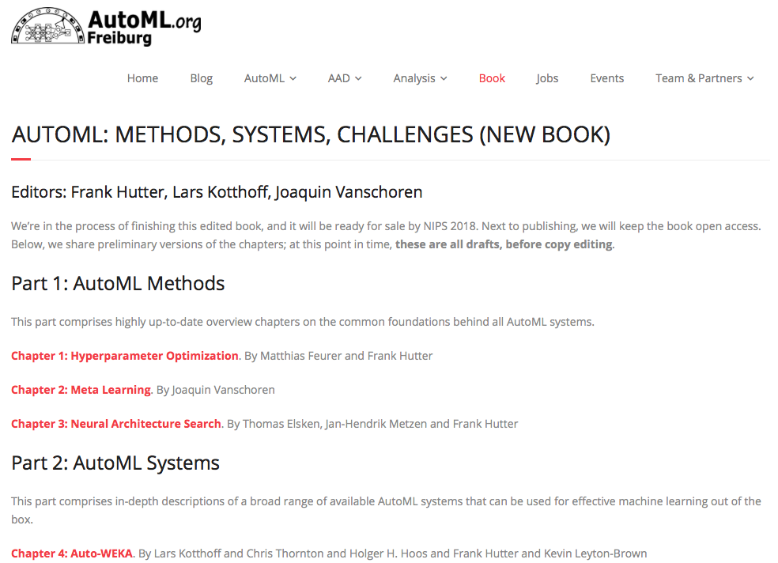
another book (not so interesting… ;-) )
https://www.automl.org/book/

